Slide 1
Unit Validation Testing
.
Prof. Durga Prasad Mohapatra
Professor
Dept.of CSE, NIT Rourkela

Slide 2
Testing Levels

Slide 3
4 Testing Levels
Software tested at 4 levels:
Unit testing
Integration testing
System testing
Regression testing

Slide 4
Test Levels
Unit testing
Test each module (unit, or component) independently
Mostly done by developers of the modules
Integration and system testing
Test the system as a whole
Often done by separate testing or QA team
Acceptance testing
Validation of system functions by the customer

Slide 5
Levels of Testing
What users
really need
Acceptance
testing
System testing
Requirements
System testing
Design
Integration testing
Integration testing
Code
Unit testing
Unit testing
Maintenance
Regression Testing

Slide 6
Unit testing
Unit testing is undertaken after a module has been coded and reviewed.
This activity is typically undertaken by the coder of the module himself in the coding phase.
Before carrying out unit testing, the unit test cases have to be designed and the test environment for the unit under test has to be developed.

Slide 7
Driver and stub modules
In order to test a single module, we need a complete environment to provide all relevant code that is necessary for execution of the module.
Besides the module under test, the following are needed to test the module:
The procedures belonging to other modules that the module under test calls.
Non-local data structures that the module accesses.
A procedure to call the functions of the module under test with appropriate parameters.

Slide 8
Modules required to provide the necessary environment (which either call or are called by the module under test) are usually not available until they too have been unit tested.
In this context, stubs and drivers are designed to provide the complete environment for a module so that testing can be carried out.
The role of stub and driver modules is pictorially shown in the following Figure.

Slide 9
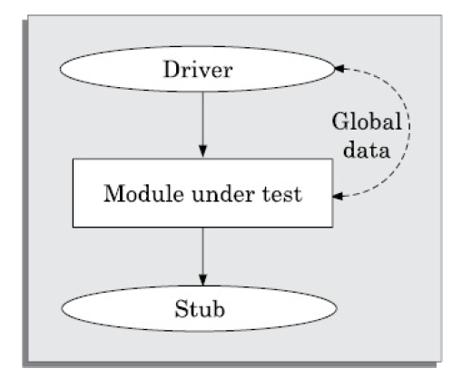
Unit testing with the help of driver and stub modules

Slide 10
Verification versus Validation
Verification is the process of determining:
Whether output of one phase of development conforms to its previous phase.
Validation is the process of determining:
Whether a fully developed system conforms to its SRS document, i.e. the module that has been prepared till now is in conformance with the requirements which were set initially in the SRS or user manual.

Slide 11
Verification versus Validation
Verification is concerned with phase containment of errors:
Whereas, the aim of validation is that the final product is error free.

Slide 12
Verification and Validation Techniques
Review
Simulation
Unit testing
Integration testing
System testing

Slide 13
Software validation is achieved by a series of black-box tests that demonstrate conformity with requirements.
Both test plan and test procedure are designed to ensure that
Functional requirements are satisfied
Behavioral characteristics achieved
Performance requirements attained
13

Slide 14
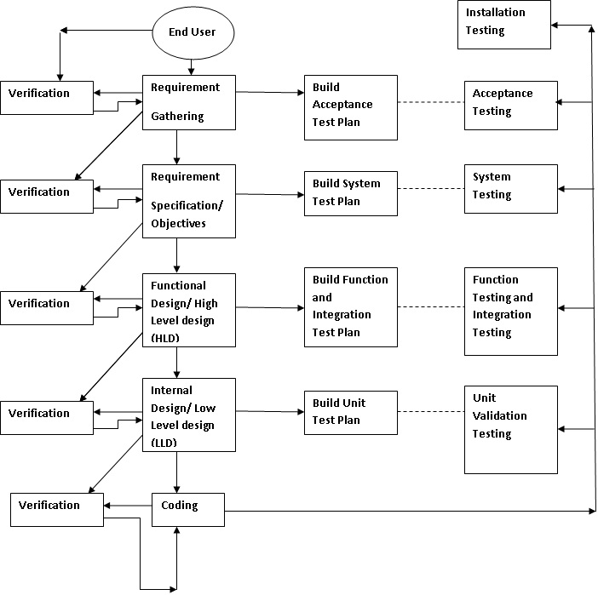
V&V activities
14

Slide 15
Unit Validation Testing
Since unit is the smallest building block of the software system, it is the first piece of system to be validated. Before we validate the entire software, units or modules must be validated.
Unit testing is normally considered an adjunct to the coding step.
Units must also be validated to ensure that every unit of software has been built in the right manner in conformance with user requirements.

Slide 16
Unit Validation Testing Cont…
Unit tests ensure that the software meets at least a baseline level of functionality prior to integration and system testing.
While developing the software, if the developer detects and removes the bug, it offers significant savings of time and costs.
This type of testing is largely based on black-box techniques.

Slide 17
Module
Software is divided into modules but a module is not an isolated entity.
The module under consideration might be getting some inputs from another module or the module is calling some other module.
It means that a module is not independent and cannot be tested in isolation.
While testing the module, all its interfaces must be simulated if the interfaced modules are not ready at the time of testing the module under consideration.

Slide 18
Drivers
Software test drivers are programs which simulate the behaviors of software components (or modules) that are the control modules of a under test module.
Control the test cases.
A driver module should contain the non-local data structures accessed by the module under test.
Additionally, it should also have the code to call the different functions of the unit under test with appropriate parameter values for testing.
The driver module may print or interpret the results produced by the module under testing.

Slide 19
Example
For example, see the design hierarchy of the modules in Figure 1.
Suppose module B is under test. In the hierarchy, module A is a superordinate of module B.
Suppose module A is not ready and B has to be unit tested.

Slide 20
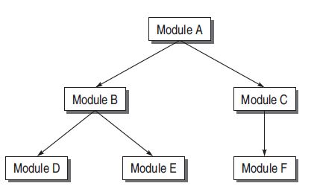
Design Hierarchy of an example system

Slide 21
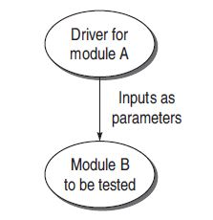
Example
A driver module is needed which will simulate module A in the sense that it passes the required inputs to module B and acts as main program for module B.

Slide 22
Drivers
Test driver is supporting the code and data used to provide an environment for testing a part of a system in isolation.
In fact, it drives the unit being tested by creating necessary ‘inputs’ required for the unit and then invokes the unit.

Slide 23
Drivers
A test driver may take inputs in the following form and call the unit to be tested:
1. It may hard-code the inputs as parameters of the calling unit.
2. It may take the inputs from the user.
3. It may read the inputs from a file.

Slide 24
Drivers
A test driver provides the following facilities to a unit to be tested:
1. Initializes the environment desired for testing.
2. Provides simulated inputs in the required format to the units to be tested.

Slide 25
Drivers
Projects where commercial drivers are not available, specialized drivers need to be developed.
This happens mainly in defense projects where projects are developed for a special application.

Slide 26
Stubs
The module under testing may also call some other module which is not ready at the time of testing.
Therefore, these modules need to be simulated for testing.
In most cases, dummy modules instead of actual modules, which are not ready, are prepared for these subordinate modules.
These dummy modules are called stubs.

Slide 27
Stub
A stub is a dummy procedure that has the same I/O parameters as the function called by the unit under test but has a highly simplified behaviour.
For example, a stub procedure may produce the expected behaviour using a simple table look up mechanism.

Slide 28
Stubs
Thus, a stub can be defined as a piece of software that works similar to a unit which is referenced by the unit being tested, but it is much simpler than the actual unit.
A stub works as a ‘stand-in’ for the subordinate unit and provides the minimum required behavior for that unit.

Slide 29
Stubs
For example, consider Figure 1 again. Module B under test needs to call module D and module E. But they are not ready.
So there must be some skeletal structure in their place so that they act as dummy modules in place of the actual modules.
Therefore, stubs are designed for module D and module E, as shown in Figure 3.

Slide 30
Example

Slide 31
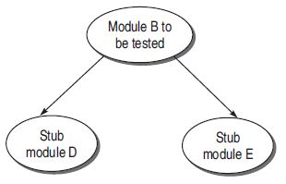
Example

Slide 32
Stubs
Stubs have the following characteristics:
1. Stub is a place holder for the actual module to be called. Therefore, it is not designed with the functionalities performed by the actual module. It is a reduced implementation of the actual module.

Slide 33
Stubs
2. It does not perform any action of its own and returns to the calling unit (which is being tested).
3. We may include a display instruction as a trace message in the body of stub. The idea is that the module to be called is working fine by accepting the input parameters.

Slide 34
Stubs
4. A constant or null must be returned from the body of stub to the calling module.
5. Stub may simulate exceptions or abnormal conditions, if required.

Slide 35
Benefits of Designing Stubs and Drivers
1. Stubs allow the programmer to call a method in the code being developed, even if the method does not have the desired behavior yet.
2. By using stubs and drivers effectively, we can cut down our total debugging and testing time by testing small parts of a program individually, helping us to narrow down problems before they expand.
3. Stubs and drivers can also be an effective tool for demonstrating progress in a business environment.

Slide 36
However, drivers and stubs represent overheads also. Overhead of designing them may increase the time and cost of the entire software system.
Therefore, they must be designed simple to keep overheads low.
Stubs and drivers are generally prepared by the developer of the module under testing.
Developers use them at the time of unit verification.
But they can also be used by any other person who is validating the unit.

Slide 37
Example
Consider the following program:
main()
{
Int a, b, c, sum, diff, mul;
scanf(“%d %d %d”, &a, &b, &c);
sum = calsum(a,b,c);
diff = caldiff(a,b,c);
mul = calmul(a,b,c);
printf(“%d %d %d”, sum, diff, mul);
}
calsum(int x, int y, int z)
{
int d;
d = x + y + z;
return(d);
}

Slide 38
Example
Suppose main() module is not ready for the testing of calsum() module. Design a driver module for main().
(b) Modules caldiff() and calmul() are not ready when called in main(). Design stubs for these two modules.

Slide 39
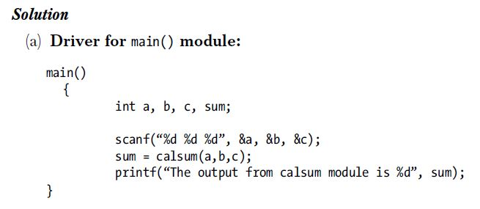
Solution

Slide 40
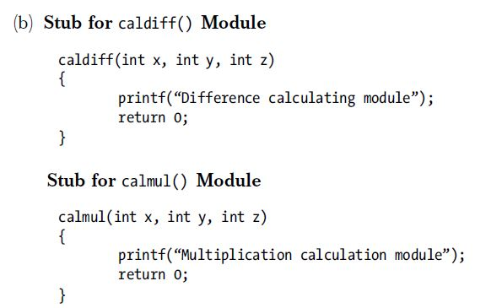
Solution

Slide 41
Summary
Discussed different levels of testing.
Explained Verification vs. Validation.
Presented V & V activities.
Discussed unit validation testing.
Explained the concept of Drivers and Stubs with an example.

Slide 42
References
Rajib Mall, Fundamentals of Software Engineering, (Chapter – 10), Fifth Edition, PHI Learning Pvt. Ltd., 2018.
Naresh Chauhan, Software Testing: Principles and Practices, (Chapter – 7), Second Edition, Oxford University Press, 2016.

Slide 43
Thank You

